Slide 1
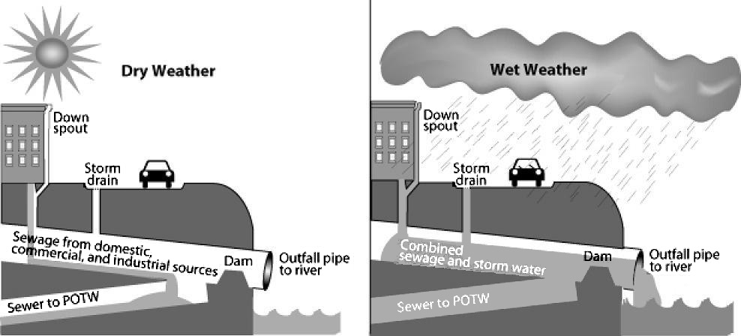
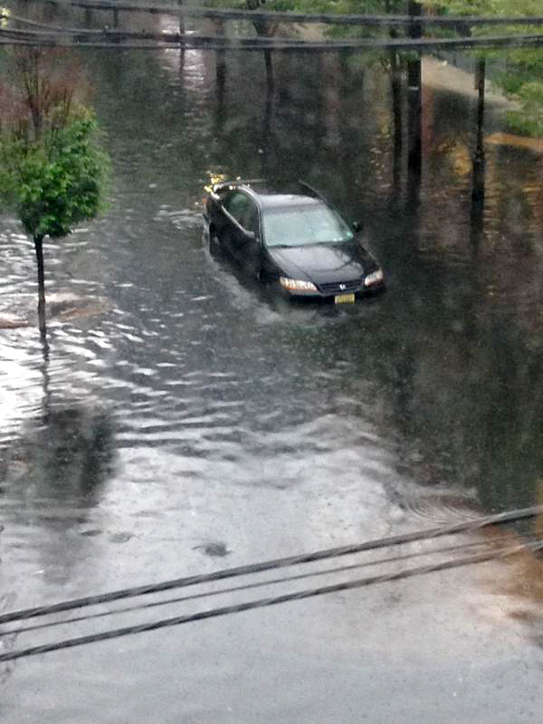
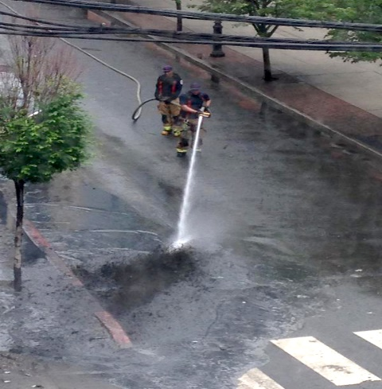
Our city’s plumbing problem
Our sewers back up into streets and spill into rivers when it rains
Our old plumbing
As long as the toilet flushes and the shower drains, we rarely think about our sewers. But in parts of our city, what we flush sometimes spills into the river and streets when it rains. That’s because we have old plumbing. Parts of our sewer system were built about 100 years ago, when putting sewage in the same pipes that took stormwater off streets was the newest technology. This is called a combined sewer system.
This is how a combined sewer system works when it’s dry and when it’s raining or snowing. Graphic courtesy of U.S. Environmental Protection Agency.
What is a CSO?
During dry weather, combined sewer pipes take sewage to the treatment plant. When it rains or snow melts, the same pipes have to handle all that extra water as well. Sometimes they can’t. When the pipes get too full, the sewage-contaminated water spills out through huge pipes into our waterways. These pipes, or outfalls, are called combined sewer overflows, or CSOs. In New Jersey, 21 communities have them.
How combined sewers may cause flooding
When sewer pipes can’t hold all of the stormwater rushing in, water can back up and flood streets or even basements. In some areas, floodwater may be contaminated with sewage. In other areas, street flooding can cause traffic jams or damage cars. This means people can’t get to work, can’t get home, and may have to live in housing that is flooded repeatedly.
Combined Sewer Problems
Health: We can get sick if we are exposed to raw sewage that has spilled in waterways from CSOs, or backed up into homes or streets.
Recreation: Sewage overflows can make recreation on rivers and streams unsafe for at least 24 to 48 hours
Environment: Sewage overflows can cause beach closures, harm aquatic habitats, contaminate shellfish beds, and dump lots of trash into waterways.
Left: Street flooding in Hoboken on June 1, 2015. Right: workers washing sewage residue off the same street after the flood. Photos courtesy of Emily Labbour, @hobokenemily.
How raw sewage can make you sick
People exposed to raw sewage can develop multiple health problems, including diarrhea and vomiting, and skin, eye, and ear infections. Contaminated water also may contain toxic chemicals that could cause short- and long-term health risks.
For more information about combined sewers, call (609) 393-0008 ext. 110 or visit www.njfuture.org/water. You also can contact your local community groups to see if they are involved with the Urban Waters Solutions Initiative.
Who is most affected in your community?
Residents of certain flood-prone neighborhoods
Commuters who must travel through flood-prone streets
Children and others who play in contaminated floodwaters
Anglers and others who use waterways with CSO outfalls
For more information and links to resources, check out the Urban Waters Solutions Initiative: www.njfuture.org/water

Slide 2
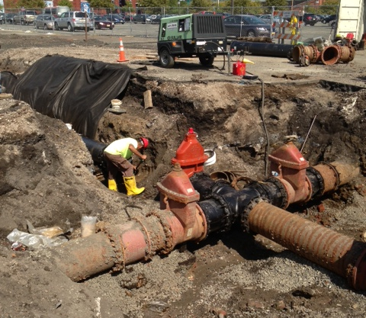
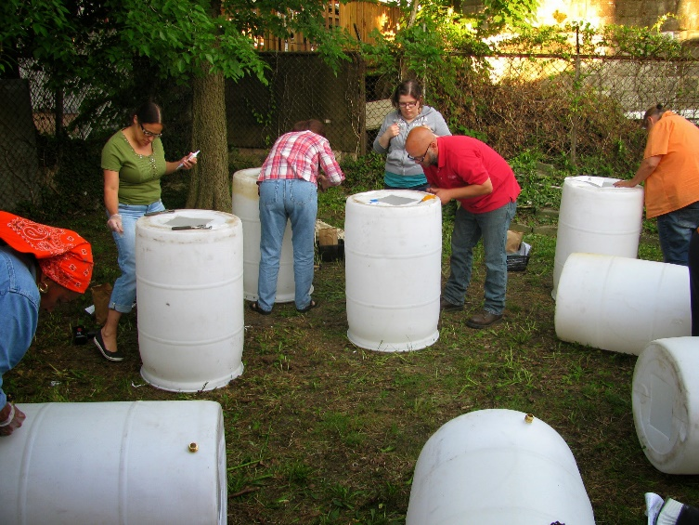
What you can do to help
Every raindrop that doesn’t go down the drain helps stop overflows
Fixing the problem
New Jersey cities already have done some work to reduce overflows. But they now must make more dramatic changes. In early 2015, New Jersey’s Dept. of Environmental Protection issued new permits to the 25 communities and sewage treatment plants that have CSOs. These entities must develop a long-term plan that outlines how they will reduce or eliminate overflows. Cities and sewage plants also must measure how often overflows occur.
Lessons from elsewhere
There is no simple solution to stopping overflows. But more than 700 communities around the U.S. have CSOs and New Jersey can learn from what already has worked. Many of those communities are using a combination of traditional “gray” infrastructure and newer “green” infrastructure.
.
Utility workers fixing pipes in Camden as part of a redevelopment project.
What is gray infrastructure?
Gray infrastructure is the hard, concrete and metal pipes, basins, and tunnels. This below-the-ground infrastructure is important, but requires a lot of money from users, and take a long time to build. Gray infrastructure will be a big part of the solution.
What is green infrastructure?
Green infrastructure methods mimic nature by allowing rain to trickle into the ground rather than going down the drain. Methods include planting trees, building rain gardens, saving rainwater, and installing special pavement that allows water to filter through. These methods also may help cool your neighborhood in the summer and make it more attractive. However, these methods have limitations as to how much water they can manage.
Volunteers and residents build rain barrels at a green-infrastructure workshop in Camden.
As cities make plans for fixing combined sewers and stopping overflows, you can share your ideas for what your community needs and how infrastructure repairs can help improve your neighborhood. Contact your local community groups for new information about public comments and about the Urban Waters Solutions Initiative.
What can you do to help?
Every drop counts. Everyone can help by doing simple things to their property that reduce the amount of water flooding into the sewer. This includes reducing how much water you use, planting trees, redirecting downspouts to rain barrels or planters, removing concrete from yards, and supporting water infrastructure projects.
For more information and links to resources, check out the Urban Waters Solutions Initiative: www.njfuture.org/water

